Slide 1
Arduino-side Reception
Notes:
syntax style: C++
The following code applies to WPA/WPA2 network. For others, refer to http://www.arduino.cc/en/Reference/WiFiBegin or http://www.arduino.cc/en/Guide/ArduinoWiFiShield for modification.
Board can only accept 1 byte at a time, so need to separately send the four bytes

Slide 2
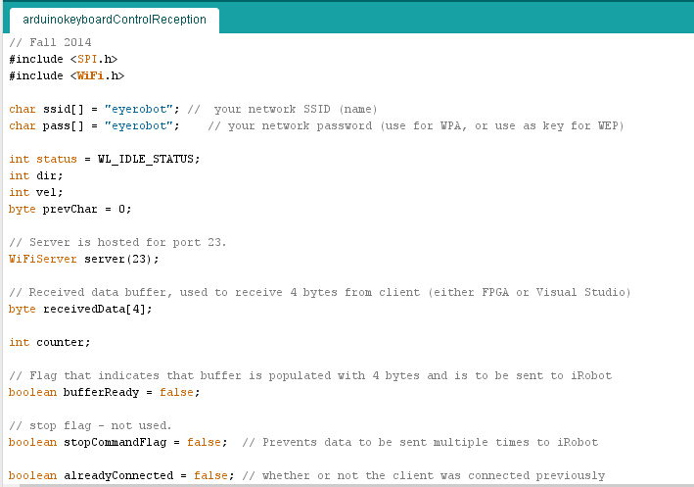
Import SPI library (Serial Peripheral Interface, to enable communication of Galileo with peripheral devices) and the WiFi library.
Declare the WiFi that Galileo should receive data from.
Server is Galileo, and Client is whoever sends out the data (Processing, Visual Studio, or FPGA)
Can only send one byte of data via Serial port a time, so Galileo needs a buffer to collect a data packet of 4 bytes (2 for velocity and 2 for orientation) before sending to iRobot

Slide 3
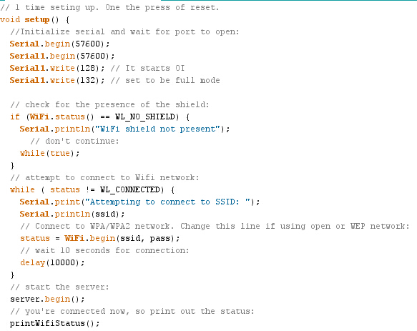
Serial refers to USB Client port. It is responsible for sending programs from other devices to Intel Galileo board. Serial1 refers to Pin 0 and Pin 1 in Intel Galileo digital pins. We use Serial1 to talk to iRobot, and Serial to enable communication between Client and Intel Galileo.
.begin() sets the data rate in bits per second (baud) for serial data transmission. write() with arguments 128 and 132 are defined parameters of the iRobot.
Some Arduino boards have WiFi shields, although it’s not the case for Galileo.

Slide 4
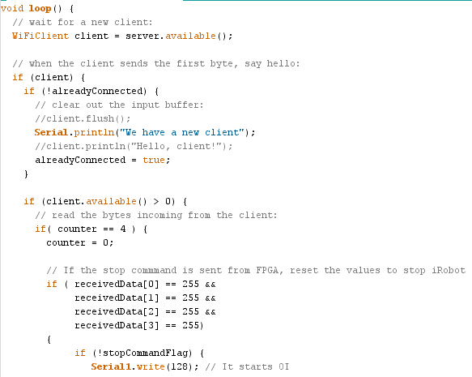
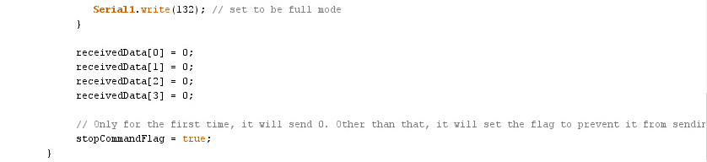
After connecting to WiFi in the one-time setup function, start data transfer in loop().
Fetch incoming data if the server is available to receive and the client is available to send.
“counter” records the state of the data buffer. Clear it before receiving new data.

Slide 5
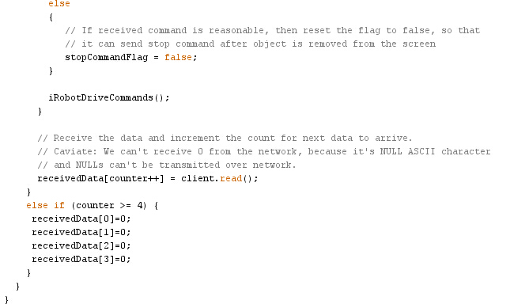
else, Galileo should continue receiving data from Client.
Remember that the condition of the outer loop for this line is “counter==4”, so we have full 4 bytes of data collected in our buffer (which might have been set to zeros in the lines above). Now demand iRobot to execute these 4 bytes
Override the 4 bytes iRobot has just executed with new data, one byte in each loop.

Slide 6
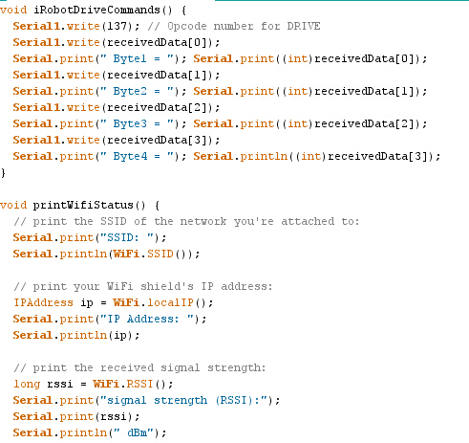
These are the two helper functions we used.

Slide 7
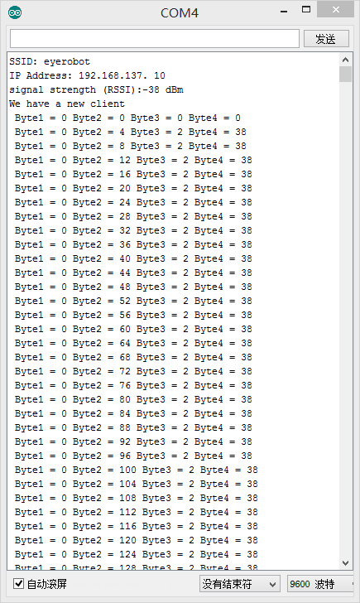
This is a snapshot from the Serial Monitor of Arduino IDE

Slide 8
2. Visual Studio Code

Slide 9
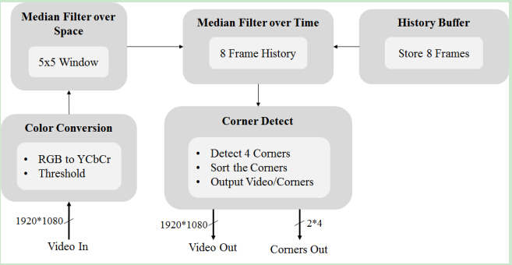
Infinite loop to process camera image
using OpenCV library
initializes: class: ClientNetwork
Initialize Client
class: ClientGame
method: NetworkServices::sendMessage()

Slide 10
Initialize Client
create an instance of the class ClientGame
ClientGame initializes ClientNetwork, which 1. initialize WinSock, connects the Galileo to the client

